Slide 1

CPE 490 Embedded Systems Lecture 10
Floating Point and Fixed Point Integers
Using pointers in function s
dsPIC 33 ALU

Slide 2
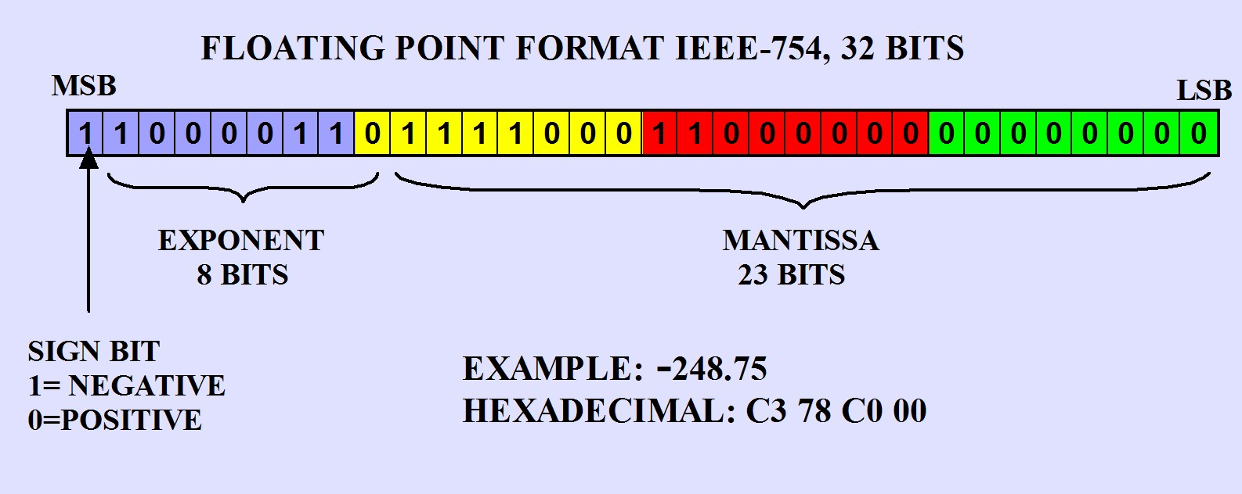
FLOATING POINT REPRESENTATION
IEEE-754 format

Slide 3
Sign Bit
Most significant bit F31 is the sign bit.
Number is negative if set.

Slide 4
Exponent
Exponent on the base 2 is bit positions F30-F23, 8 bits in the 32 bit word
The exponent is calculated this way
Binary value (F30-F23) – 0x 7F
The range can be from 2¹²⁸ to 2⁻¹²⁷

Slide 5
Mantessa
An implicit binary 1 is always assumed
Think of the number as:
1.XXX XXXX XXXX XXXX XXXX XXXX (23 Bits in Mantessa)
Exponent moves binary point to the right if positive and to the left if negative

Slide 6
To Calculate a Decimal Number as Floating Point
If a negative number set F31 = 1 else 0
If the absolute value of the number is greater than one find out how many bits come before the decimal point. Call this number B_{>1}
if the absolute value is less than 1 than (B_{>1} ) is the negative integer that makes the following true:
1.XXX * 2^(B_{>1}) (multiply by 2 until a digits past the dp)
Exponent = B_{>1} + 0X7F
Skip to step 5
Calculate your exponent to be that many bits:
Exponent = B_{>1} + 0X7F -1 (for the implicit 1)

Slide 7
To Calculate a Decimal Number as Floating Point
Load the binary values for the B_{>1} into the MSB of the mantissa not including the MS 1 (that is implicit). If more than 23 truncate and you have the floating point. If B_{>1} <1 then don’t load anything
Find out how many bits are left to represent the fractional part:
B_{<1} = 24 – B_{>1} If the result is a negative number B_{<1} = 0 or > 24 then make it 24

Slide 8
To Calculate a Decimal Number as Floating Point
B_{<1} is the number of binary digits you have to represent the fraction . This value can be seen as:
Binary digits to the left as an integer / 2^(B_{<1} )= fraction part of number
Therefore the rest of the mantissa to the left of the binary point is:
Fraction part of number * 2^(B_{<1} )
Load this binary number into the rest of the mantissa if B_{>1} < 1 then remove the first binary 1 and load the rest into the mantissa

Slide 9

Example
Set MSB F31 to 1 (step 1)
B_{>1} = (248 = 0xF8) 8 bits (step 2)
Exponent = B_{>1} + 0X7F -1= 7 + 0x7f = 0x86 (step 4)
Load 111 1000 into mantissa (step 5)
B_{<1} = 24 – B_{>1} = 24-8 = 16 (step 6)

Slide 10
Example
Remaining mantissa = fractional part X 2^(B_{<1}) =.75 * 2^16 = 49152 = 0XC000 (step 8)

Slide 11
Embedded System Resource Management
Variables can be declared to be char - 8 bit to long double floating point - 64 bits.
The type that you use effects the amount of memory used in the embedded system as well as the execution time of a program.
For example a floating point math will be much slower than straight integer math
Notes:
C language hides the complexity but can not hide the effect on the resources.
You can not blindly use the most flexible most precise data type which would be long double without greatly effecting performance.
Remember
Char =8 bits
Int, short = 16 bits
Long = 32 bits
Long long = 64 bits
Float, double = 32 bits
Long double = 64 bits

Slide 12
Keeping it Integer
Hardware support like the multiplier or ALU adder will only work with integer operands.
In some large microprocessors they have hardware support for floating point math.
BUT, most smaller microprocessors do not so how can you best use the hardware that you have?

Slide 13
Fixed Point Math
Fixed point math will assume a constant position of the decimal point for a number.
We can make any floating point number into this format by aligning the decimal point to the agreed to position
This can be accomplished by multiplying the floating point number by 2^m where m is the number of bits used to represent the fraction part.

Slide 14
Think about it
I can take any number that has fractional content and make it into an integer
I make it into an integer by remembering what I multiplied before and then I can divide by that amount later
In base 10 the easiest to multiply by 10^m where m is number of digits of fraction that I will recover.
Example = 125.475 and be made into an integer by multiplying by 10^3 , you get an integer of 125475.
Can do the same thing in binary by multiplying by 2^m

Slide 15
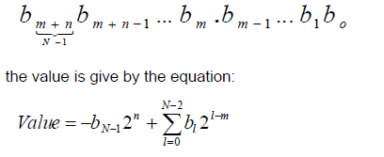
Fixed Integer in Qn.m = Qm format
A fixed integer of the Qn.m format will have:
m binary bits to the right of the decimal
n binary digits to the left of the decimal
Add a sign bit at the MSB place (don’t count the sign
Total bits = N = m+n+1
Notes:
In the signed case this is two’s complement representation.

Slide 16
Resolution and Range
Resolution = 2^{-m}
Max = 2^{n-1} – 2^{-m}
Min = - 2^{-n}
Notes:
M binary digits to the right
n binary digits to the left

Slide 17
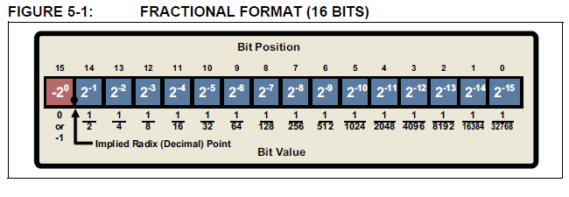
Supported Format Q1.15 =Q15
Resolution = 2^-15 = .000030517
Max = 1- 2^-15
Min = -1

Slide 18
Useful in Multiply
If two numbers in the Q1.15 form than you can do integer multiplication getting a 32 bit (long answer)
This can be thought of multiplying two integers together that both have factors of 2^-15.
So just shift the answer to the right to right by 15 to get the correct answer

Slide 19
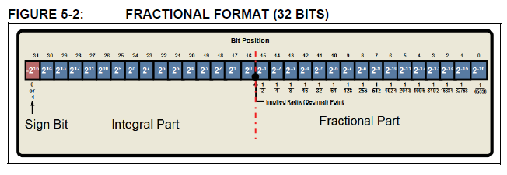
Supported Format Q15.16
Resolution 2^-16 = .000015258
Max 2^15 – 2^-16 =32767.99998
Min -2^15 = -32768
Notes:
Demonstrate add in mplab

Slide 20
dsPIC DSP Hardware for Math
Instruction set is divided into MCU and DSP instructions
DSP has the ability of fetching two operands from data memory and do the following in one cycle
Hardware multiply of 16 bit by 16 bit
40 bit added to 40 bits
Multiply and accumulate
Shift 16 bits to the left or the right
Automatic rounding and overflow notification

Slide 21
MCU ALU
Non DSP support for 16 bit wide addition subtraction, bit shifts and logic operations
Using the high-speed 17-bit x 17-bit multiplier of the DSP engine, the ALU supports unsigned, signed or mixed-sign operation in several MCU multiplication modes:
16-bit x 16-bit signed
16-bit x 16-bit unsigned
16-bit signed x 5-bit (literal) unsigned
16-bit unsigned x 16-bit unsigned
16-bit unsigned x 5-bit (literal) unsigned
16-bit unsigned x 16-bit signed
8-bit unsigned x 8-bit unsigned
Notes:
Why 17 bit because a 16 bit unsigned number needs to be signed extended to the 17 bit which will be positive.

Slide 22
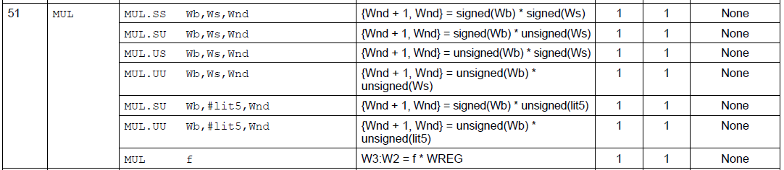
Assembly Language Multiply
# of words
# of cycles
Status flags effected
Any combination of signed an unsigned is supported.
Operands are 16 bit (sign extended to 17 bits) and the answer is 32 bits.
Only one operand can be in data memory for unsigned multiplication (last command)
Notes:
Section 23 of data sheet

Slide 23
MCU ALU Division
The divide block supports 32-bit/16-bit and 16-bit/16-bit signed and unsigned integer divide operations with the following data sizes:
32-bit signed/16-bit signed divide
32-bit unsigned/16-bit unsigned divide
16-bit signed/16-bit signed divide
16-bit unsigned/16-bit unsigned divide

Slide 24
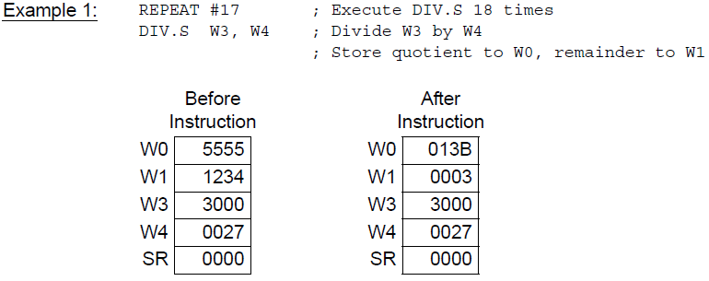
MCU ALU Division
Must use the REPEAT instruction with the assembler div instruction to repeat the div instruction will take 19 instruction cycles.
Notes:
Details for instruction set can be found in:
16-bit MCU and DSC Programmer’s
Reference Manual
High-Performance Microcontrollers (MCU)
and Digital Signal Controllers (DSC)
This will be posted on blackboard

Slide 25
Call by Value
Call by value: When an argument is passed to a subroutine, it is a copy of the variable used, the actual variable that is used in the call does not change. For example:
main() sqr_it(int x)
{ {
int t=10; x=x*x;
sqr_it(t) return(x);
} }
At the end of main the value of t is 10 not 100

Slide 26
Call by Reference
Call by reference: allows the call variable to be changed by the function. In C this is accomplished by passing a pointer to the variable instead of a copy of the variable data.
swap(int *x, int *y) Example of a call to swap:
{ main()
int temp; {
temp = *x; int x=10, y=20;
*x=*y; swap(&x, &y);
*y=temp; }
}

Slide 27
Problems with Pointer – Unitialized
A pointer gone ‘wild’ can write anywhere causing very nasty bugs
This code is very bad
main() // this program is wrong
{
int x, *p;
x = 10;
*p = x;
}

Slide 28
Problem with Pointers Misunderstand
Example of misunderstanding in code
main ()
{
int x, *p;
x = 10;
p = x; /* you think p now points to x but instead p points to address 10 */
}

Slide 29
Pointer and Structures
You can declare a pointer to a structure for example
struct bal{
float balance;
char name[80];
} person;
struct bal *p;
p = &person
p-> balance = 52.75;
Notes:
-> is the arrow operator it has the highest priority

Slide 30
Pointers to Functions
return-type (*pointer-name)(type var-name1, type var-name2,…. Type var-namen)
Example
void (*p) (int i); //declare pointer
(*p)(4); //will call a function with an argument of 4
This can be useful when a function needs to call another function that you can pass to it with a pointer.
Notes:
p points to a function that returns a void and takes one integer argument

